Slide 1


MUSIC GENRE CLASSIFIER
HOME
TABLE OF CONTENTS
PLAYLIST
01
Introduction
02
Method
03
Experiments & Results
04
Future Work
By Amit Karp and Ilay Yavlovich
THANKS!

Slide 2
01
Introduction
HOME
TABLE OF CONTENTS
PLAYLIST
01
Introduction
Music classification is used by many individuals and companies to better our music experience.
In this project, our goal was to build a model that will classify a song genre using the MTG-Jamendo dataset.
Our work will be based on the articels:
“Evaluation of CNN-based Automatic Music Tagging Models”
“Receptive Field Regularization Techniques for Audio Classification and Tagging with Deep Convolution Neural Networks”
02
Method
03
Experiments & Results
04
Future Work
THANKS!

Slide 3
The MTG-Jamendo dataset
HOME
HOME
TABLE OF CONTENTS
TABLE OF CONTENTS
PLAYLIST
PLAYLIST
An 87 genres dataset containing over 55,000 full stereo tracks
All tracks are multi-labeled, meaning that a song can have more then one genre.
We will work on the top 10 genres that contain the most tracks, and we will use only single label songs.
Problem Vs Solution
01
Introduction
01
Main Product
02
Method
02
Market & Competition
03
Experiments & Results
03
Business Model
04
Future Work
04
THANKS!
THANKS!

Slide 4
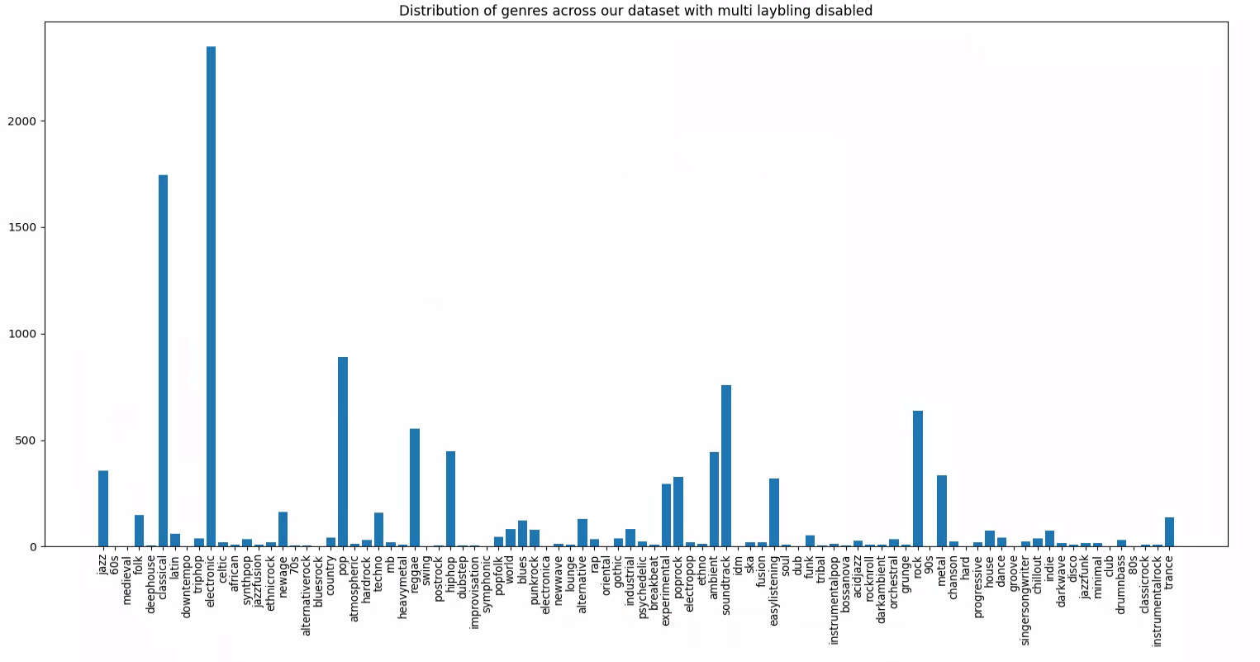
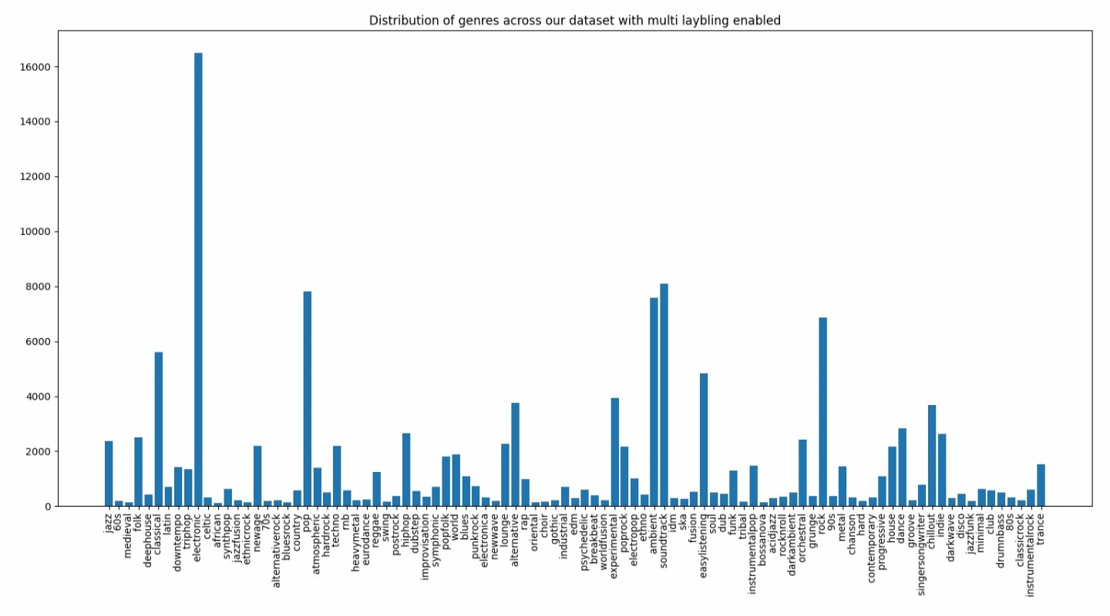
Dataset Augmentations
HOME
HOME
TABLE OF CONTENTS
TABLE OF CONTENTS
PLAYLIST
PLAYLIST
Problem Vs Solution
01
Introduction
01
Main Product
02
Method
02
Market & Competition
03
Experiments & Results
03
Business Model
04
Future Work
04
THANKS!
THANKS!

Slide 5
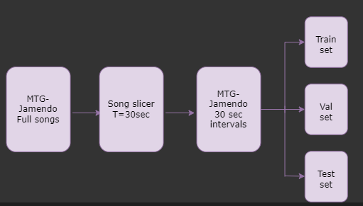
02
Method
HOME
TABLE OF CONTENTS
PLAYLIST
01
Introduction
02
Method
03
Experiments & Results
04
Future Work
THANKS!
Notes:
Using 30 second Samples as input **Full songs are entered to each section

Slide 6
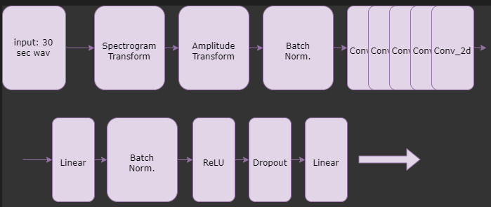
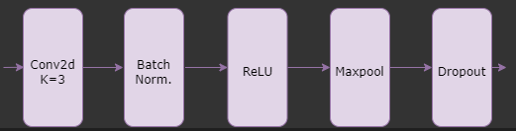
02
Method
HOME
TABLE OF CONTENTS
PLAYLIST
01
Introduction
02
Method
03
Experiments & Results
04
Future Work
THANKS!
Notes:
Network based of the work of Minz Won, Janne Spijkervet and Keunwoo Choi – for Gtzan Besides the conv layers else is FC
Pooling changes between layers of Conv output D changes depending on number of genres

Slide 7
03
Experiments & Results
HOME
TABLE OF CONTENTS
PLAYLIST
01
Introduction
Using our architecture, we decided to check 4 scenarios:
Our output with no changes
Our output using majority rule
Our output using weights
Our output using majority rule and using weights
02
Method
03
Experiments & Results
04
Future Work
THANKS!

Slide 8
Majory Rule
64%
68%
HOME
HOME
HOME
Output
TABLE OF CONTENTS
TABLE OF CONTENTS
TABLE OF CONTENTS
PLAYLIST
Introduction
01
02
Method
Weights
Weights & MR
03
Experiments & Results
04
Future Work
30%
37%
THANKS!
THANKS!
THANKS!

Slide 9
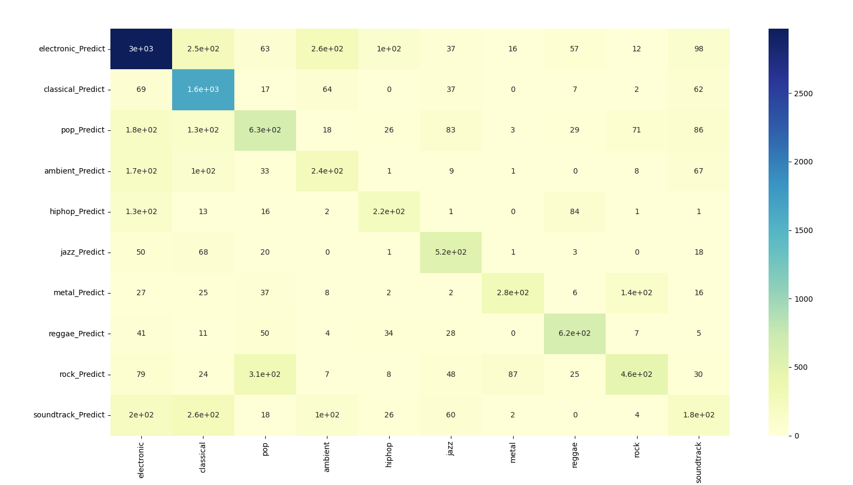
Output without Majority Rule
HOME
HOME
HOME
TABLE OF CONTENTS
TABLE OF CONTENTS
TABLE OF CONTENTS
PLAYLIST
PLAYLIST
PLAYLIST
Problem Vs Solution
Problem Vs Solution
01
Introduction
01
01
Main Product
Main Product
02
Method
02
02
Market & Competition
Market & Competition
03
Experiments & Results
03
03
Business Model
Business Model
04
Future Work
04
04
THANKS!
THANKS!
THANKS!

Slide 10
Majory Rule
64%
68%
HOME
HOME
HOME
Output
TABLE OF CONTENTS
TABLE OF CONTENTS
TABLE OF CONTENTS
PLAYLIST
PLAYLIST
PLAYLIST
Problem Vs Solution
Problem Vs Solution
01
Introduction
01
01
Main Product
Main Product
02
Method
02
02
Weights
Weights & MR
Market & Competition
Market & Competition
03
Experiments & Results
03
03
Business Model
Business Model
04
Future Work
04
04
30%
37%
THANKS!
THANKS!
THANKS!

Slide 11
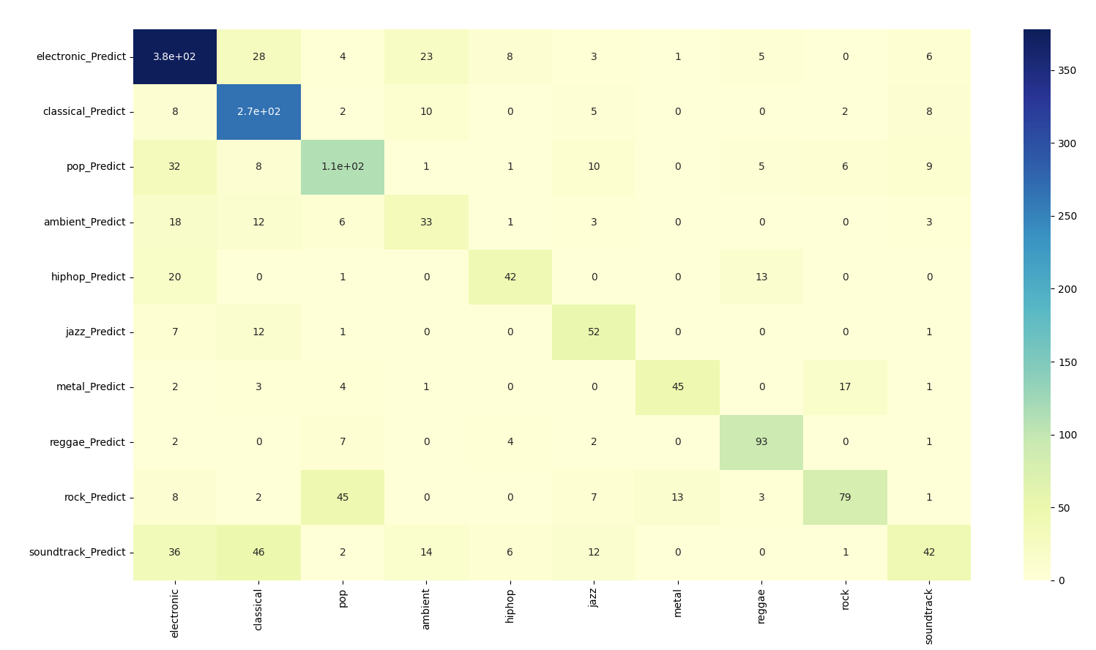
Output with Majority Rule
HOME
HOME
HOME
TABLE OF CONTENTS
TABLE OF CONTENTS
TABLE OF CONTENTS
PLAYLIST
PLAYLIST
PLAYLIST
Problem Vs Solution
Problem Vs Solution
01
Introduction
01
01
Main Product
Main Product
02
Method
02
02
Market & Competition
Market & Competition
03
Experiments & Results
03
03
Business Model
Business Model
04
Future Work
04
04
THANKS!
THANKS!
THANKS!

Slide 12
Majory Rule
64%
68%
HOME
HOME
HOME
Output
TABLE OF CONTENTS
TABLE OF CONTENTS
TABLE OF CONTENTS
PLAYLIST
PLAYLIST
PLAYLIST
Problem Vs Solution
Problem Vs Solution
01
Introduction
01
01
Main Product
Main Product
02
Method
02
02
Weights
Weights & MR
Market & Competition
Market & Competition
03
Experiments & Results
03
03
Business Model
Business Model
04
Future Work
04
04
30%
37%
THANKS!
THANKS!
THANKS!

Slide 13
04
Future Work
HOME
TABLE OF CONTENTS
PLAYLIST
01
Introduction
02
Method
Paths for the future:
Splitting the songs to 15 second samples.
Adding multi-label option
Improving weights.
03
Experiments & Results
04
Future Work
THANKS!
Notes:
From a study we read using smaller segments will be more beneficial, but the study didn't check segments smaller than 30 sec so future work we’d like to see if gives better results.

Slide 14
Thanks!
HOME
TABLE OF CONTENTS
PLAYLIST
01
Introduction
Method
any questions? https://github.com/IlayYavlovich/046211-MusicGenreClassifier.git
02
03
Experiments & Results
04
Future Work
THANKS!
Notes:
From a study we read using smaller segments will be more beneficial, but the study didn't check segments smaller than 30 sec so future work we’d like to see if gives better results.

